Slide 2

2
3
Lesson 23
Probability I-
Classical Probability

Slide 3

Lead in

Slide 4

Lead in

Slide 5

Example

Slide 6

Example

Slide 7

Example

Slide 8
Example

Slide 9

Example

Slide 10

Example

Slide 11
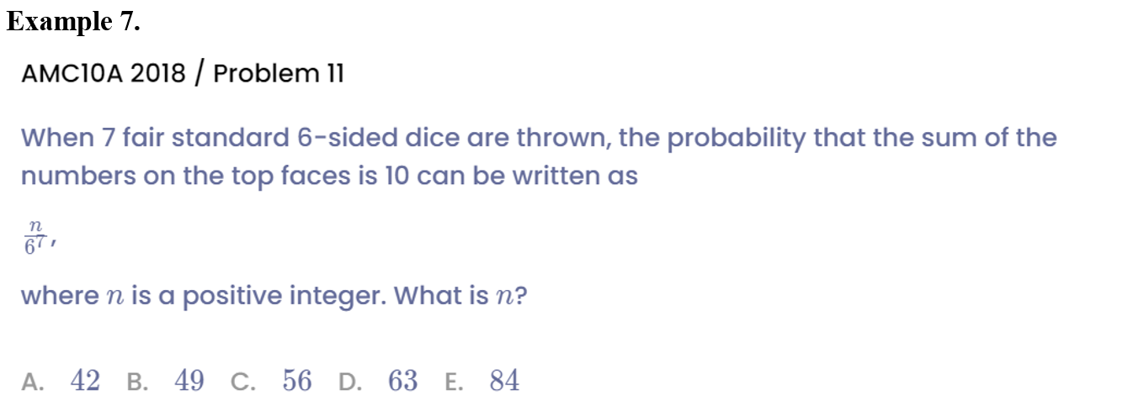
Example

Slide 12

Example

Slide 13

Example

Slide 14

Example

Slide 15
See You Next Time!

